Slide 1

CS 561: Artificial Intelligence
Instructor: Prof. Laurent Itti, itti@pollux.usc.edu
TA: Jimmy Tanner, jimmyt857@gmail.com
Lectures: M-W 14:00 – 15:20, SOS-B46
Office hours: Mon 13:00 – 13:50, HNB-07A
This class will use blackboard.usc.edu
- Up to date information
- Lecture notes
- Relevant dates, links, etc.
Course material:
[AIMA] Artificial Intelligence: A Modern Approach,
by Stuart Russell and Peter Norvig. (3rd ed)

Slide 2
CS 561: Artificial Intelligence
Course overview: foundations of symbolic intelligent systems. Agents, search, problem solving, logic, representation, reasoning, symbolic programming, and robotics.
Prerequisites: CS 455x, i.e., programming principles, discrete mathematics for computing, software design and software engineering concepts. Good knowledge of C++ and STL required for programming assignments.
Grading: 25% for midterm +
25% for final +
50% for mandatory homeworks/assignments

Slide 3
Practical issues
Class mailing list:
will be setup on the backboard system
Homeworks: See class web page on blackboard
Jan 27 – HW1 out
Feb 12 – HW1 due
Feb 19 – HW2 out
Mar 10 – HW2 due
Mar 26 – HW3 out
Apr 19 – HW3 due
Apr 14 – HW4 out
Apr 30 – HW4 due
Late homeworks: you lose 20% of the homework’s grade per 24-hour period that you are late. Do not be late, as the penalty grows very fast: grade = points * (1 – n * 0.2) where n is the number of days late (n=0 if submitted on time, n=1 is submitted between 1 second and 24h late, etc).
Grade review / adjustment: Requests will be considered up to 2 weeks after the grade is released. After that, it will be too late and requests for regrading will be denied.
Exams:
Mar 26 – midterm (in class)
May 12 – final (2-4pm, room TBA)

Slide 4
Academic Integrity
Familiarize yourself with the USC Academic Integrity guidelines.
Violations of the Student Conduct Code will be filed with the Office of Student Judicial Affairs, and appropriate sanctions will be given.
Homework assignments are to be solved individually.
You are welcome to discuss class material in review groups, but do not discuss how to solve the homeworks.
Exams are closed-book with no questions allowed.

Slide 5
Academic Integrity
All students are responsible for reading and following the Student Conduct Code. Note that the USC Student Conduct Code prohibits plagiarism.
Some examples of what is not allowed by the conduct code: copying all or part of someone else's work (by hand or by looking at others' files, either secretly or if shown), and submitting it as your own; giving another student in the class a copy of your assignment solution; and consulting with another student during an exam. If you have questions about what is allowed, please discuss it with the instructor.
Students who violate university standards of academic integrity are subject to disciplinary sanctions, including failure in the course and suspension from the university. Since dishonesty in any form harms the individual, other students, and the university, policies on academic integrity will be strictly enforced. Violations of the Student Conduct Code will be filed with the Office of Student Judicial Affairs.

Slide 6
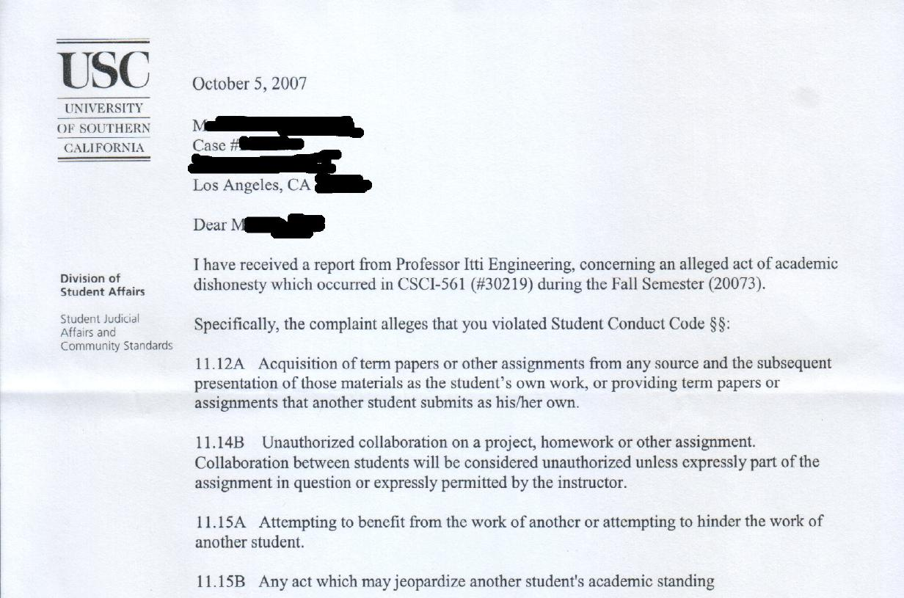

Slide 7
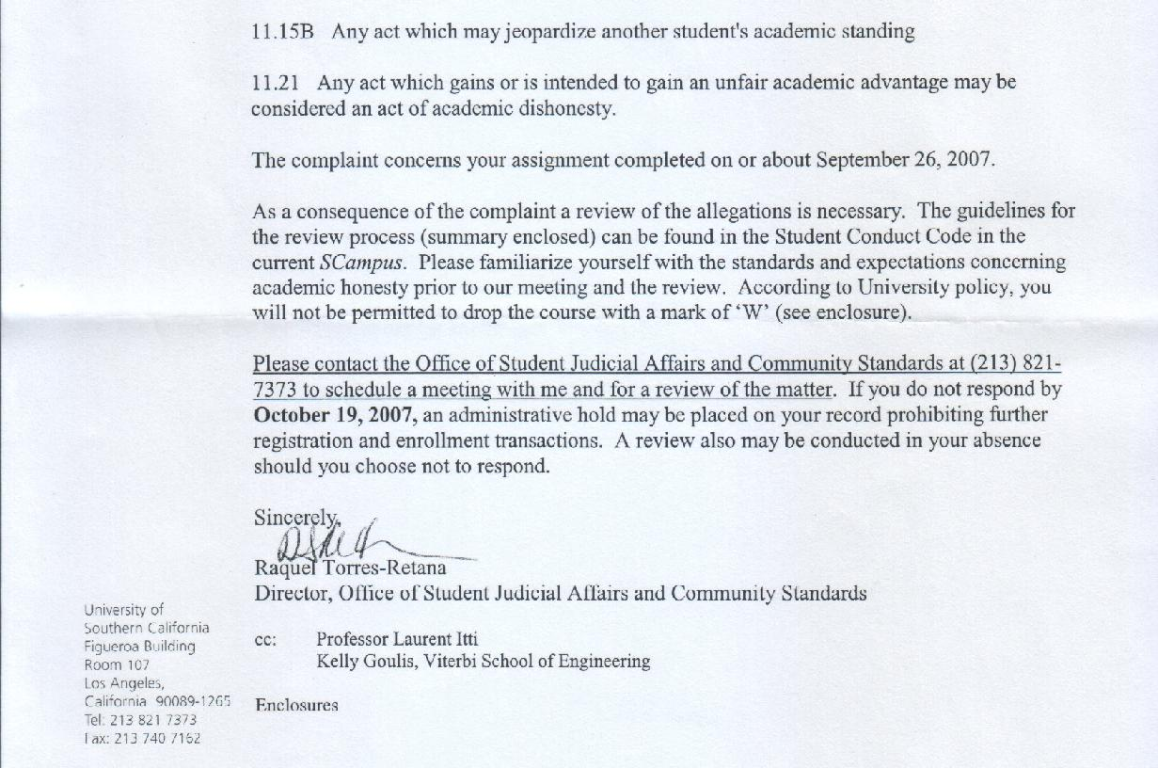

Slide 8
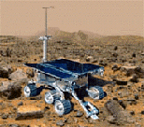

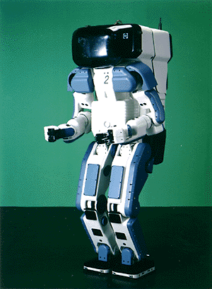

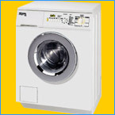
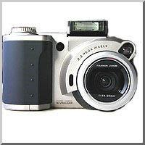

Why study AI?
Search engines
Science
Medicine/
Diagnosis
Labor
Appliances
What else?

Slide 9
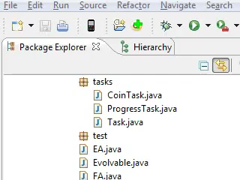
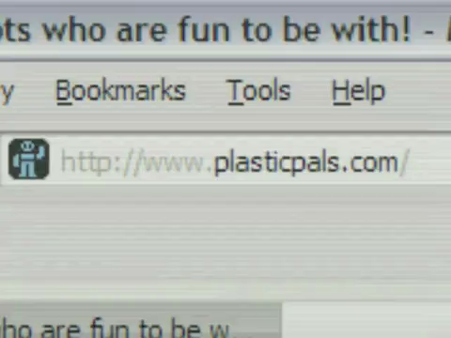
Why study AI?

Slide 10
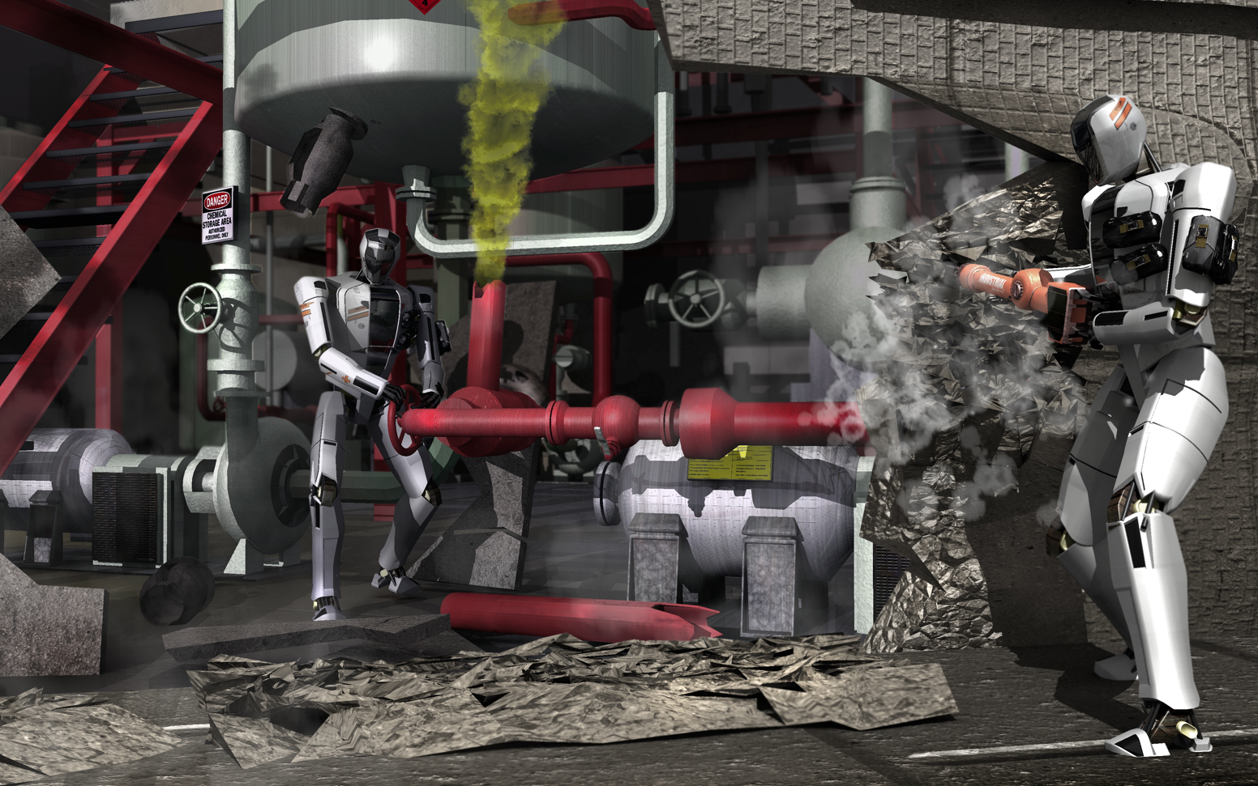
DARPA Robotics Challenge

Slide 11
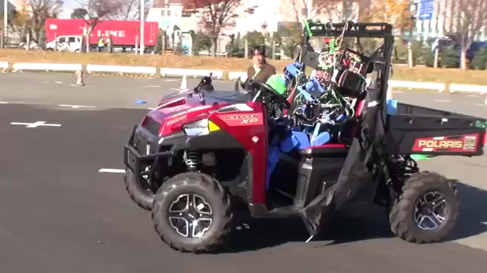

Slide 12
What is AI?
The exciting new effort to make computers thinks … machine with minds, in the full and literal sense”
(Haugeland 1985)
“The study of mental faculties through the use of computational models”
(Charniak et al. 1985)
“The art of creating machines that perform functions that require intelligence when performed by people” (Kurzweil, 1990)
A field of study that seeks to explain and emulate intelligent behavior in terms of computational processes” (Schalkol, 1990)
Systems that think like humans
Systems that think rationally
Systems that act like humans
Systems that act rationally

Slide 13
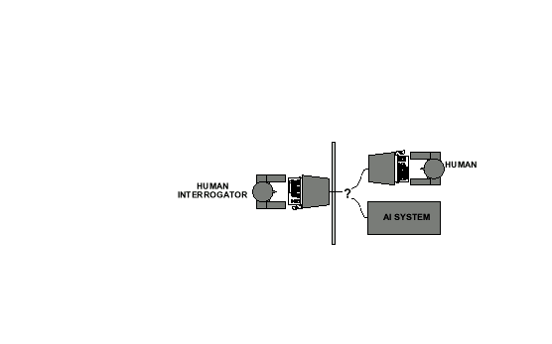
Acting Humanly: The Turing Test
Alan Turing's 1950 article Computing Machinery and Intelligence discussed conditions for considering a machine to be intelligent
“Can machines think?” ←→ “Can machines behave intelligently?”
The Turing test (The Imitation Game): Operational definition of intelligence.

Slide 14
Acting Humanly: The Turing Test
Computer needs to possess: Natural language processing, Knowledge representation, Automated reasoning, and Machine learning
Are there any problems/limitations to the Turing Test?

Slide 15
Acting Humanly: The Full Turing Test
Alan Turing's 1950 article Computing Machinery and Intelligence discussed conditions for considering a machine to be intelligent
“Can machines think?” ←→ “Can machines behave intelligently?”
The Turing test (The Imitation Game): Operational definition of intelligence.
Computer needs to posses:Natural language processing, Knowledge representation, Automated reasoning, and Machine learning
Problem: 1) Turing test is not reproducible, constructive, and amenable to mathematic analysis. 2) What about physical interaction with interrogator and environment?
Total Turing Test: Requires physical interaction and needs perception and actuation.

Slide 16
Acting Humanly: The Full Turing Test
Problem:
1) Turing test is not reproducible, constructive, and amenable to mathematic analysis.
2) What about physical interaction with interrogator and environment?

Slide 17
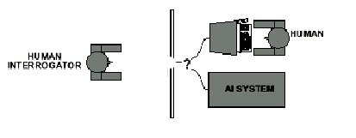
Acting Humanly: The Full Turing Test
Problem:
1) Turing test is not reproducible, constructive, and amenable to mathematic analysis.
2) What about physical interaction with interrogator and environment?
Trap door

Slide 18
What would a computer need to pass the Turing test?
Natural language processing: to communicate with examiner.
Knowledge representation: to store and retrieve information provided before or during interrogation.
Automated reasoning: to use the stored information to answer questions and to draw new conclusions.
Machine learning: to adapt to new circumstances and to detect and extrapolate patterns.

Slide 19
What would a computer need to pass the Turing test?
Vision (for Total Turing test): to recognize the examiner’s actions and various objects presented by the examiner.
Motor control (total test): to act upon objects as requested.
Other senses (total test): such as audition, smell, touch, etc.

Slide 20
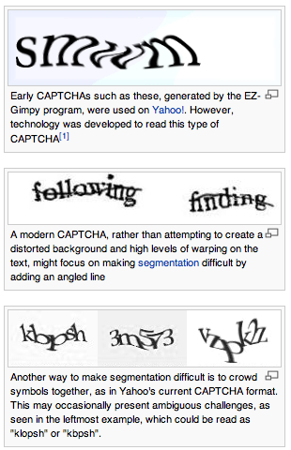
CAPTCHAs or “reverse Turing tests”
Vision is a particularly difficult one for machines…
Gave rise to “Completely Automated Public Turing test to tell Computers and Humans Apart” (CAPTCHA)
wikipedia

Slide 21
Thinking Humanly: Cognitive Science
1960 “Cognitive Revolution”: information-processing psychology replaced behaviorism
Cognitive science brings together theories and experimental evidence to model internal activities of the brain
What level of abstraction? “Knowledge” or “Circuits”?
How to validate models?
Predicting and testing behavior of human subjects (top-down)
Direct identification from neurological data (bottom-up)
Building computer/machine simulated models and reproduce results (simulation)
21

Slide 22
Thinking Rationally: Laws of Thought
Aristotle (~ 450 B.C.) attempted to codify “right thinking” What are correct arguments/thought processes?
E.g., “Socrates is a man, all men are mortal; therefore Socrates is mortal”
Several Greek schools developed various forms of logic: notation plus rules of derivation for thoughts.

Slide 23
Thinking Rationally: Laws of Thought
Problems:
Uncertainty: Not all facts are certain (e.g., the flight might be delayed).
Resource limitations:
Not enough time to compute/process
Insufficient memory/disk/etc
Etc.

Slide 24
Acting Rationally: The Rational Agent
Rational behavior: Doing the right thing!
The right thing: That which is expected to maximize the expected return
Provides the most general view of AI because it includes:
Correct inference (“Laws of thought”)
Uncertainty handling
Resource limitation considerations (e.g., reflex vs. deliberation)
Cognitive skills (NLP, AR, knowledge representation, ML, etc.)
Advantages:
More general
Its goal of rationality is well defined

Slide 25
How to achieve AI?
How is AI research done?
AI research has both theoretical and experimental sides. The experimental side has both basic and applied aspects.
There are two main lines of research:
One is biological, based on the idea that since humans are intelligent, AI should study humans and imitate their psychology or physiology.
The other is phenomenal, based on studying and formalizing common sense facts about the world and the problems that the world presents to the achievement of goals.
The two approaches interact to some extent, and both should eventually succeed. It is a race, but both racers seem to be walking. [John McCarthy]

Slide 26
Branches of AI
Logical AI
Search
Natural language processing
pattern recognition
Knowledge representation
Inference From some facts, others can be inferred.
Automated reasoning
Learning from experience
Planning To generate a strategy for achieving some goal
Epistemology Study of the kinds of knowledge that are required for solving problems in the world.
Ontology Study of the kinds of things that exist. In AI, the programs and sentences deal with various kinds of objects, and we study what these kinds are and what their basic properties are.
Genetic programming
Emotions???
…

Slide 27
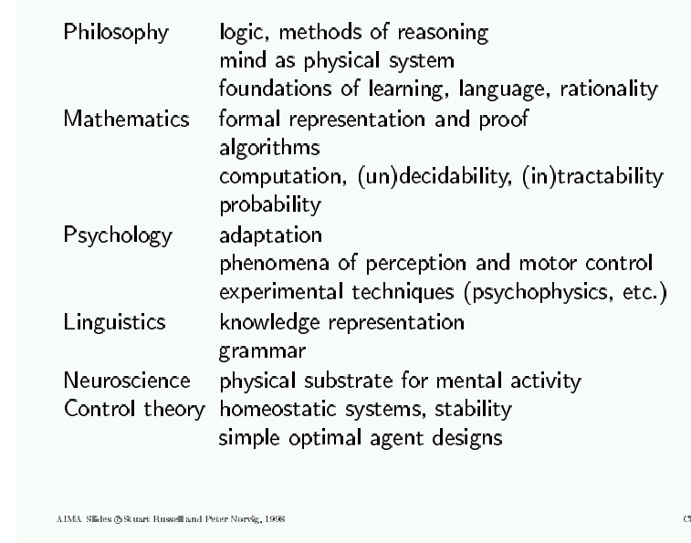
AI Prehistory
27

Slide 28
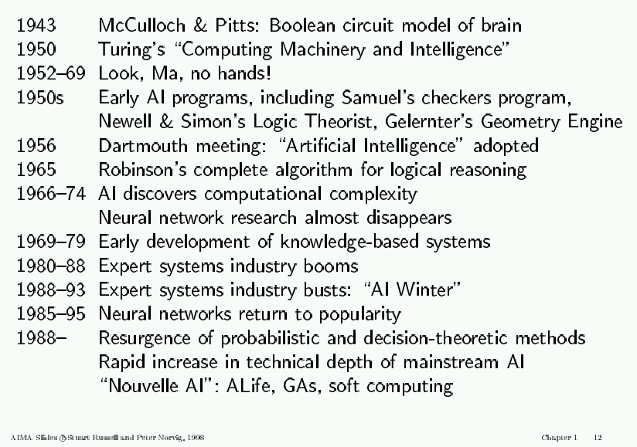
AI History

Slide 29
AI State of the art
Have the following been achieved by AI?
World-class chess playing
Playing table tennis
Cross-country driving
Solving mathematical problems
Discover and prove mathematical theories
Engage in a meaningful conversation
Understand spoken language
Observe and understand human emotions
Express emotions
…

Slide 30

AI State of the art

Slide 31

AI State of the art

Slide 32

AI State of the art

Slide 33
Course Overview
General Introduction
01-Introduction. [AIMA Ch 1] Course Schedule. Homeworks, exams and grading. Course material, TAs and office hours. Why study AI? What is AI? The Turing test. Rationality. Branches of AI. Research disciplines connected to and at the foundation of AI. Brief history of AI. Challenges for the future. Overview of class syllabus.
02-Intelligent Agents. [AIMA Ch 2] What is
an intelligent agent? Examples. Doing the right
thing (rational action). Performance measure.
Autonomy. Environment and agent design.
Structure of agents. Agent types. Reflex agents.
Reactive agents. Reflex agents with state.
Goal-based agents. Utility-based agents. Mobile
agents. Information agents.
Agent
sensors
effectors

Slide 34
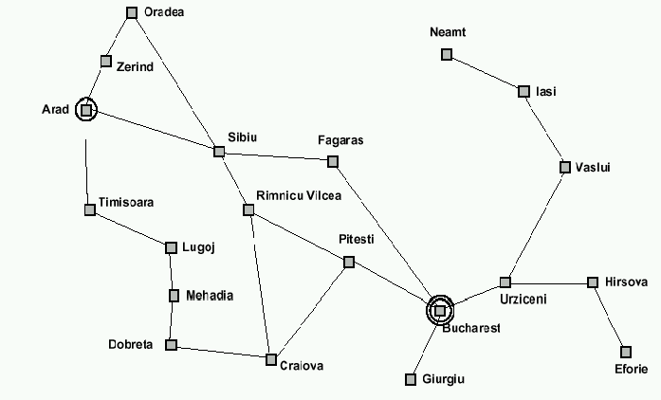
Course Overview (cont.)
How can we solve complex problems?
03/04-Problem solving and search. [AIMA Ch 3] Example: measuring problem. Types of problems. More example problems. Basic idea behind search algorithms. Complexity. Combinatorial explosion and NP completeness. Polynomial hierarchy.
05-Uninformed search. [AIMA Ch 3] Depth-first. Breadth-first. Uniform-cost. Depth-limited. Iterative deepening. Examples. Properties.
06/07-Informed search. [AIMA Ch 4] Best-first. A* search. Heuristics. Hill climbing. Problem of local extrema. Simulated annealing. Genetic algorithms.
9 l
3 l
5 l
Using these 3 buckets,
measure 7 liters of water.
Traveling salesperson problem

Slide 35
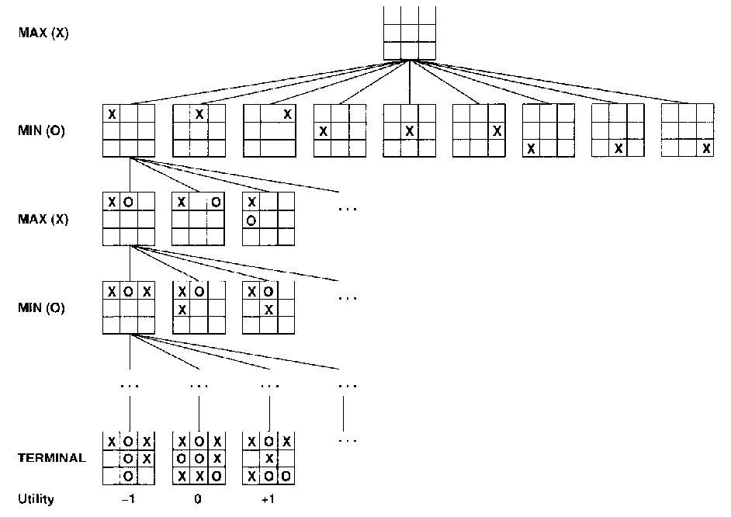
Course Overview (cont.)
Practical applications of search.
08-Game playing. [AIMA Ch 5] The minimax algorithm. Resource limitations. Aplha-beta pruning. Elements of
chance and non-
deterministic games.
tic-tac-toe
35

Slide 36
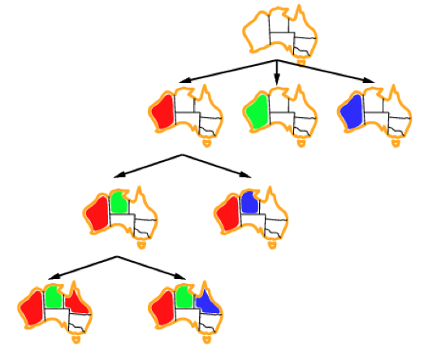
Course Overview (cont.)
Search under constraints
09-Constraint satisfaction. [AIMA Ch 6] Node, arc, path, and k-consistency. Backtracking search. Local search using min-conflicts.
Map coloring
36

Slide 37
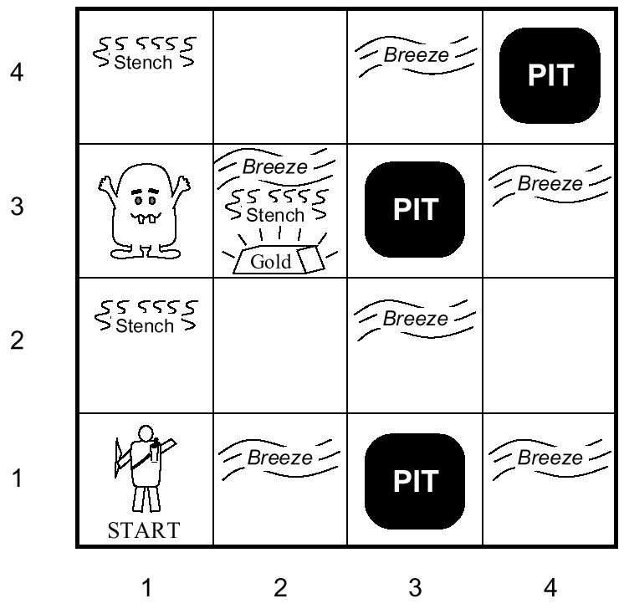
Course Overview (cont.)
10-Agents that reason logically 1. [AIMA Ch 7] Knowledge-based agents. Logic and representation. Propositional (boolean) logic.
11-Agents that reason logically 2. [AIMA Ch 7] Inference in propositional logic. Syntax. Semantics. Examples.
Towards intelligent agents
wumpus world

Slide 38
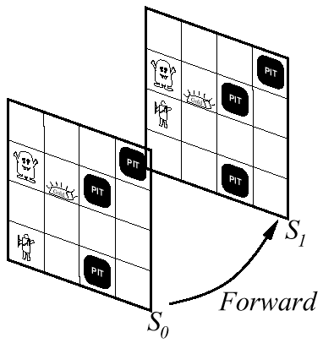
Course Overview (cont.)
Building knowledge-based agents: 1st Order Logic
12-First-order logic 1. [AIMA Ch 8] Syntax. Semantics. Atomic sentences. Complex sentences. Quantifiers. Examples. FOL knowledge base. Situation calculus.
13-First-order logic 2.
[AIMA Ch 8] Describing actions.
Planning. Action sequences.

Slide 39
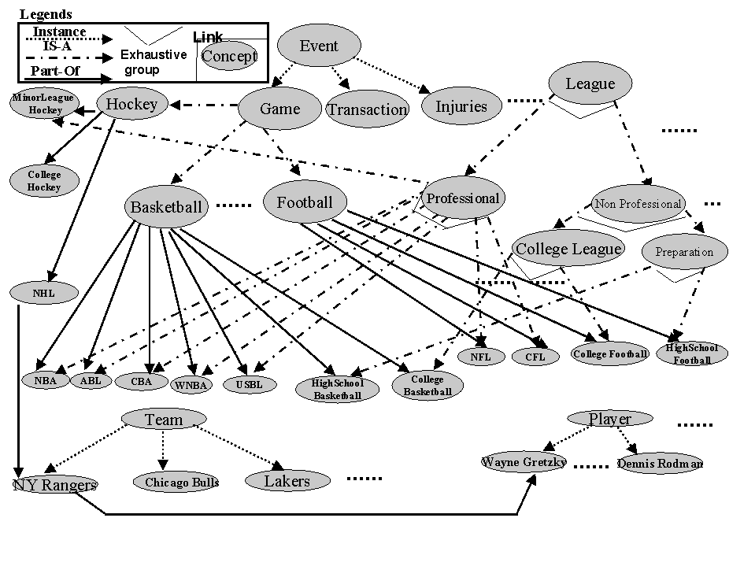
Course Overview (cont.)
Representing and Organizing Knowledge
14/15-Building a knowledge base. [AIMA Ch 12] Knowledge bases. Vocabulary and rules. Ontologies. Organizing knowledge.
An ontology
for the sports
domain

Slide 40
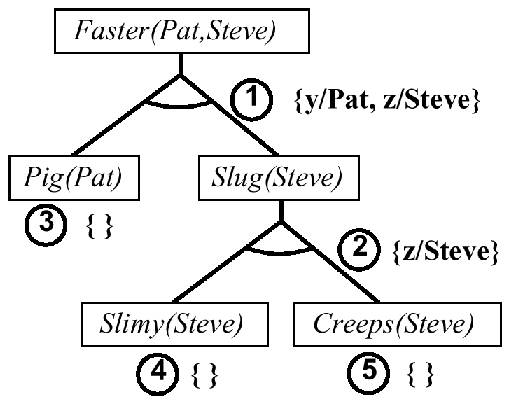
Course Overview (cont.)
Reasoning Logically
16/17/18-Inference in first-order logic. [AIMA Ch 9] Proofs. Unification. Generalized modus ponens. Forward and backward chaining.
Example of
backward chaining

Slide 41
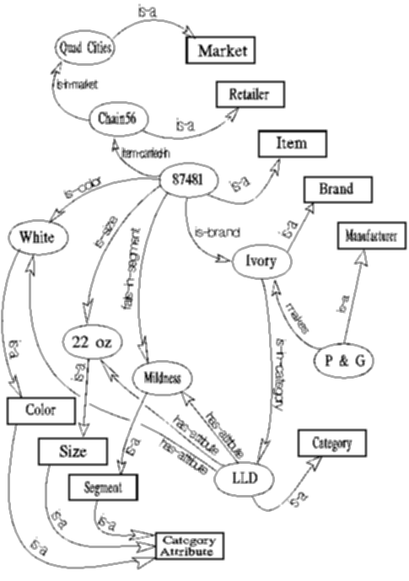
Course Overview (cont.)
Examples of Logical Reasoning Systems
19-Logical reasoning systems.
[AIMA Ch 9] Indexing, retrieval
and unification. The Prolog language.
Theorem provers. Frame systems
and semantic networks.
Semantic network
used in an insight
generator (Duke
university)

Slide 42
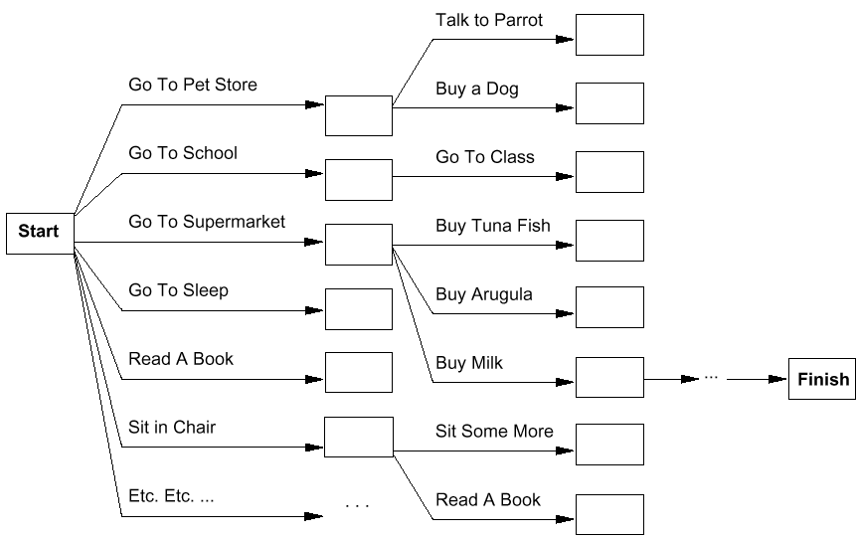
Course Overview (cont.)
Systems that can Plan Future Behavior
20-Planning. [AIMA Ch 10] Definition and goals. Basic representations for planning. Situation space and plan space. Examples.

Slide 43
Course Overview (cont.)
Handling fuzziness, change, uncertainty.
21-Fuzzy logic. [handout]. Fuzzy variables, fuzzy inference, aggregation, defuzzification.
Center of gravity
Center of largest area

Slide 44
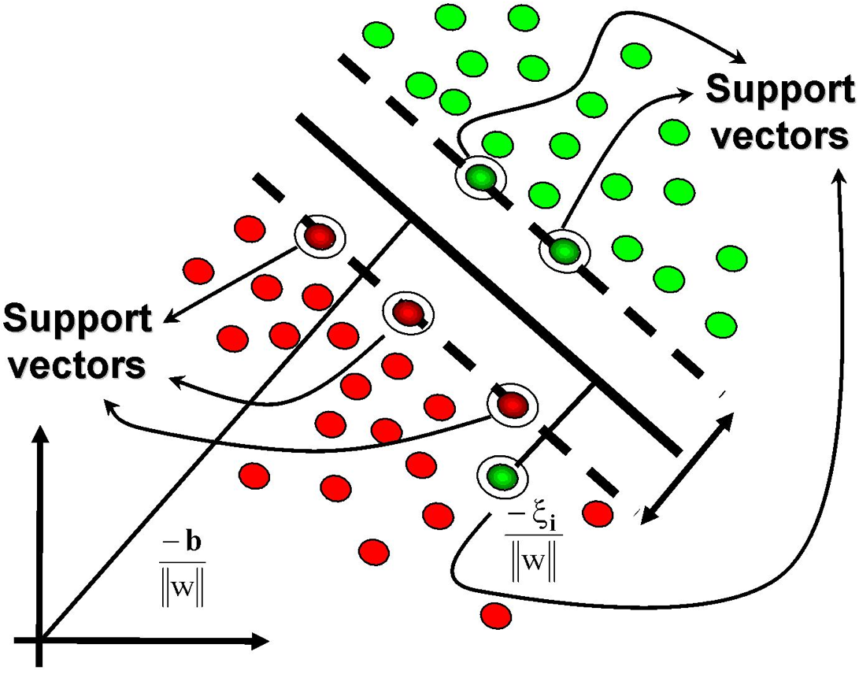
Course Overview (cont.)
Handling fuzziness, change, uncertainty.
22-Learning. [AIMA 18 + handout]. Supervised learning, learning decision trees, support vector machines.

Slide 45
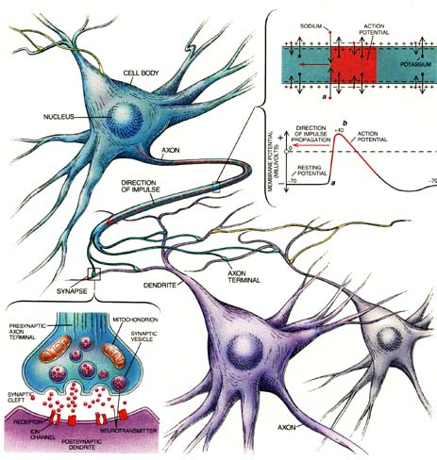
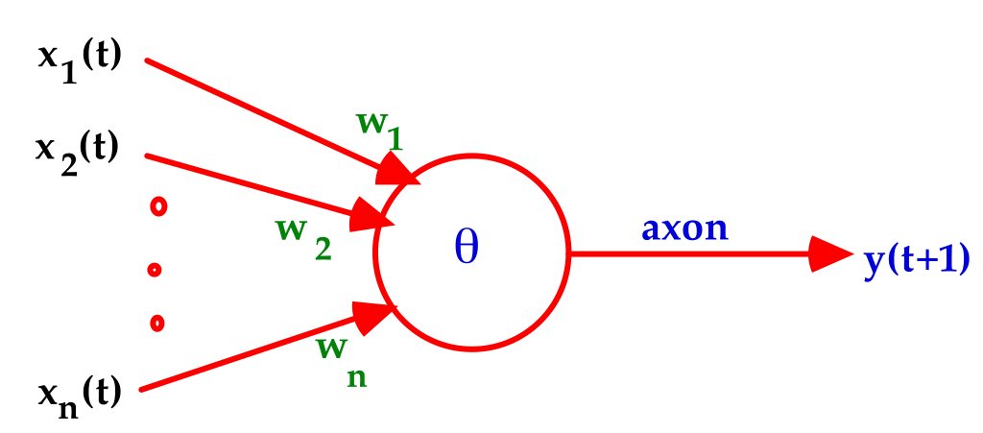
Course Overview (cont.)
Learning with Neural networks
23-Neural Networks.
[Handout + AIMA 18] Introduction to perceptrons, Hopfield networks, self-organizing feature maps. How to size a network? What can neural networks achieve?

Slide 46
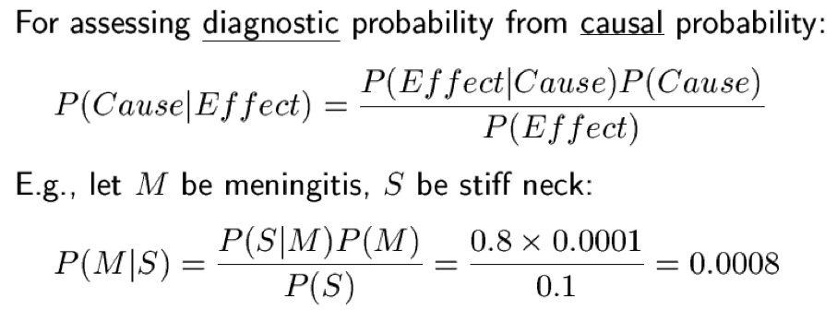
Course Overview (cont.)
24/25-Probabilistic reasoning. [AIMA Ch 13, 14, 15]
Reasoning under uncertainty – probabilities, conditional independence, Markov blanket, Bayes nets. Probabilistic reasoning in time. Hidden Markov Models, Kalman filters, dynamic Bayesian networks.
Handling fuzziness, change, uncertainty.

Slide 47
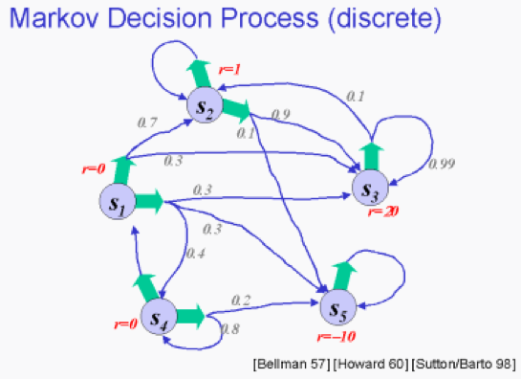
Course Overview (cont.)
26-Probabilistic decision making. [AIMA 16, 17]
– utility theory, decision networks, value iteration, policy iteration, Markov decision processes.
Handling fuzziness, change, uncertainty.

Slide 48
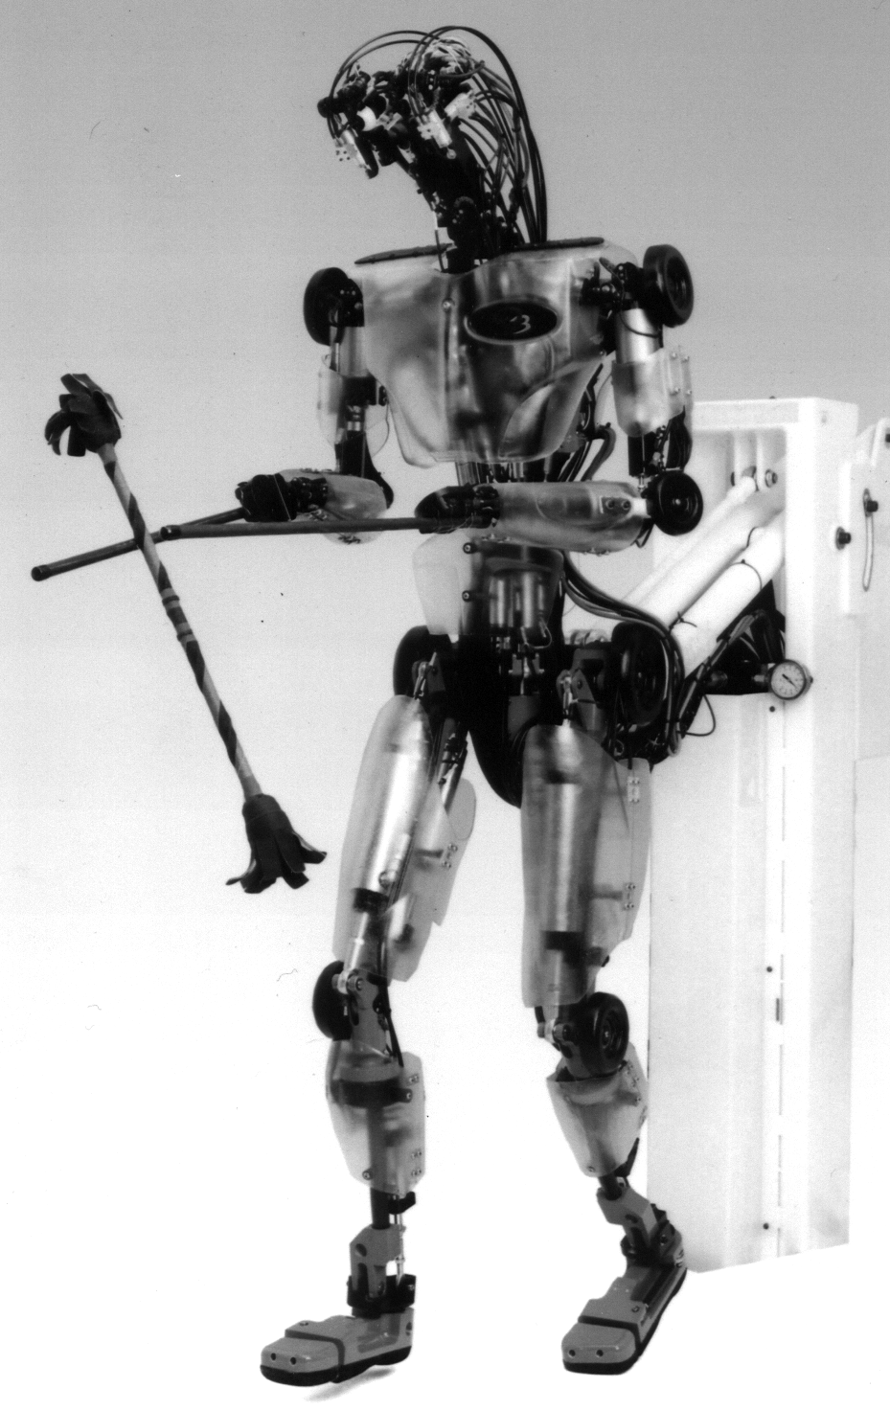
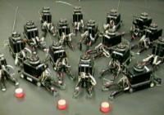
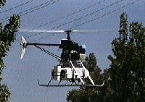
Course Overview (cont.)
What challenges remain?
27-Challenges in perception. [AIMA Ch 24] Particularly vision.
28-Towards intelligent machines. [AIMA Ch 26, 27] The challenge of robots: with what we have learned, what hard problems remain to be solved? Different types of robots. Tasks that robots are for. Parts of robots. Architectures. Configuration spaces. Navigation and motion planning. Towards highly-capable robots. What have we learned. Where do we go from here?
robotics@USC

